Slide 1
CSS & DOM Manipulation Performance Best Practices

Slide 2
CSS Contain predictable isolation of a DOM subtree

Slide 3
contain: layout | paint | size | style content | strict

Slide 4
contain: layout
contain: paint
contain: size
layout relative to border-box
border-box is the visible boundary
border-box requires dimensions

Slide 5
contain: layout

Slide 6
performance impact
contain: layout
shield from outer layout
contains inner layouting
skip child nodes from layouting
contained nodes
offscreen nodes

Slide 7
design impact
contain: layout
relative position form container
new stacking-context
for children
z-2
z-1
layout relative to border-box
relative nodes
contained nodes

Slide 8
contain: layout - lab measurement
unoptimized
onscreen
offscreen
90ms Rendering 90ms Paint
16ms Rendering 5ms Paint
15ms Rendering 0ms Paint
the target nodes DOM contains only layout work, the example contains a trigger which effects only layout properties, the measure is performed in 3 steps form none to layout and one with layout and all nodes offscreen

Slide 9
Test Lab
🧪

Slide 10
contain: paint

Slide 11
performance impact
contain: paint
shield from outer paint
reduces paint area by cutting edges
skip invisible nodes from paint
skip out of viewport nodes from paint
paint area reduced to border-box
contained nodes
obscured nodes
offscreen nodes
offscreen container

Slide 12
design impact
contain: paint
cuts paint area at border-box
border-box is the visible boundary
visible area

Slide 13
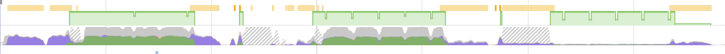
contain: paint - lab measurement
unoptimized
onscreen
offscreen
6.00ms Paint
1.00ms Paint
0.15ms Paint
the target nodes DOM contains only paint work, the example contains a trigger which effects only paint properties, the measure is performed in 3 steps form none to paint and one with paint and all nodes offscreen

Slide 14
Test Lab
🧪

Slide 15
contain: size

Slide 16
performance impact
contain: size
ignores nodes
for size calculation
basically none - on its own
contained nodes

Slide 17
design impact
container dimensions
collapse
border-box requires dimensions
static dimensions

Slide 18
contain: shorthands

Slide 19
contain: content
contain: strict
contain: layout paint
contain: layout paint size

Slide 20
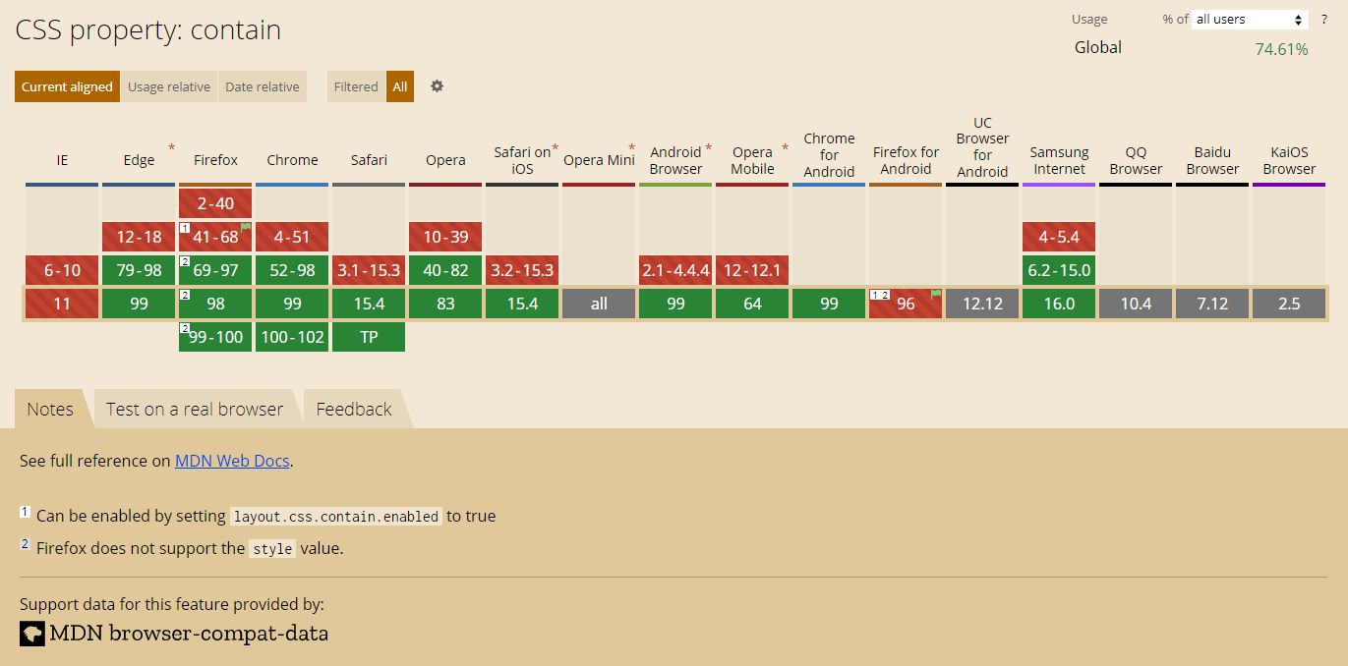

Slide 21
CSS Contain Defining Layout Root

Slide 22
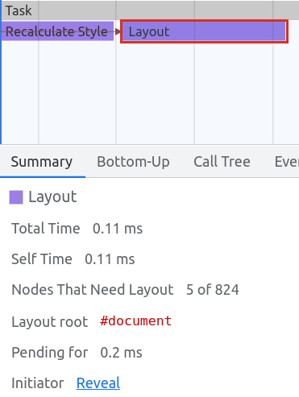
CSS Contain Defining Layout Root
💡
every layout task has a root
root determines nodes that need to be inspected and/or relayouted

Slide 23
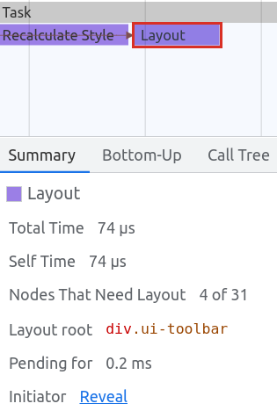
CSS Contain Defining Layout Root
🔥

Slide 24
CSS Contain Defining Layout Root
💡
preconditions for a layout root (non-exhaustive list):
contain: layout & defined dimensions
contain: strict
overflow: hidden & defined dimensions & on its own layer

Slide 25

Demo Time!
Layout Root

Slide 26
Content Visibility Native Virtual Scrolling

Slide 27
content-visibility: auto|hidden|visible

Slide 28
performance impact
content-visibility: auto
nodes layout benefits
from contain
nodes paint benefits
from contain
ignores nodes
outside the viewport
layout & paint containment + detach offscreen nodes
contained nodes
contained nodes
offscreen nodes

Slide 29
design impact
content-visibility: auto
ignores nodes
outside the viewport
border-box requires dimensions offscreen
static dimensions

Slide 30
contain-intrinsic-size: px|auto

Slide 31
contain-intrinsic-size
💡
define dimensions for node in order to not collapse when offscreen
🤯
contain-intrinsic-size: auto
browser determines size automatically after first visit (IntersectionObserver + ResizeObserver)
border-box requires dimensions offscreen
https://developer.mozilla.org/en-US/docs/Web/CSS/contain-intrinsic-size

Slide 32
demo measurement

Slide 33
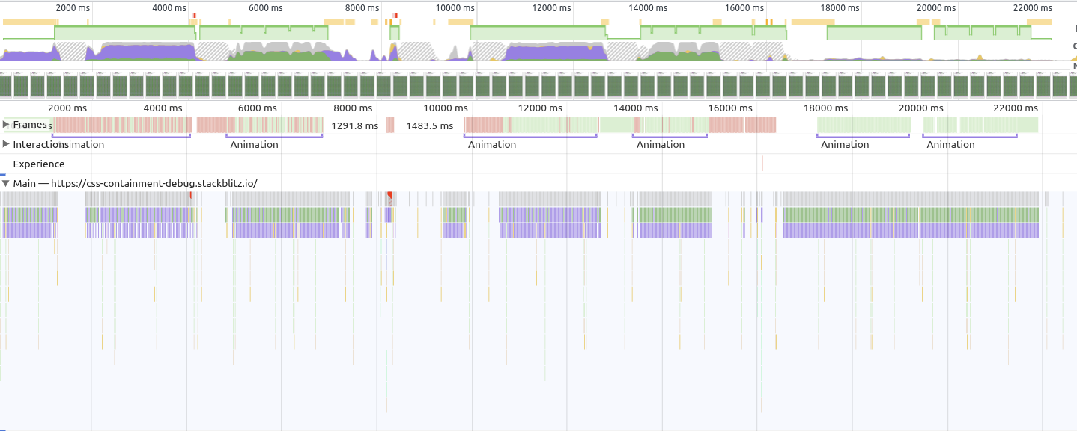
content-visibility: auto - lab measurement
unoptimized
onscreen
offscreen
6.00ms Paint
1.00ms Paint
0.1ms Paint
11ms Update Layer Tree
0,5ms Update Layer Tree
61 μs Update Layer Tree

Slide 34
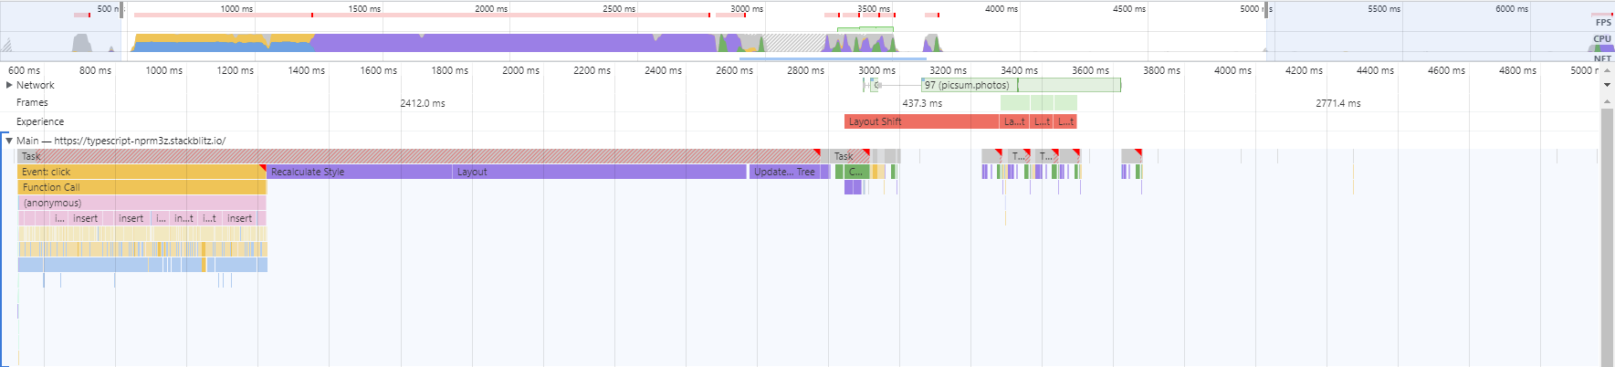
unoptimized - bootstrap
Recalculate styles
layout
hit test, paint , composite
Add DOM nodes
offscreen paint / layout of images

Slide 35
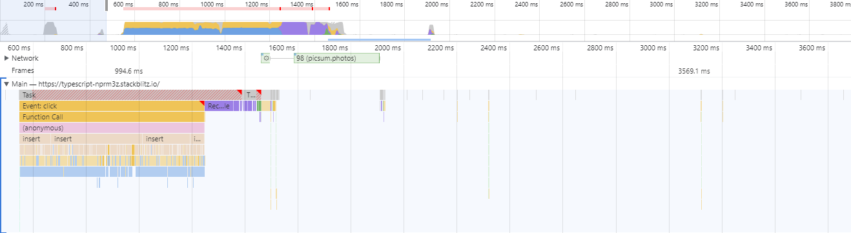
optimized - bootstrap - inc. offscreen nodes
Add DOM nodes
Recalculate styles, hit test, layout, paint ,composite
NO offscreen paint / layout of images

Slide 36
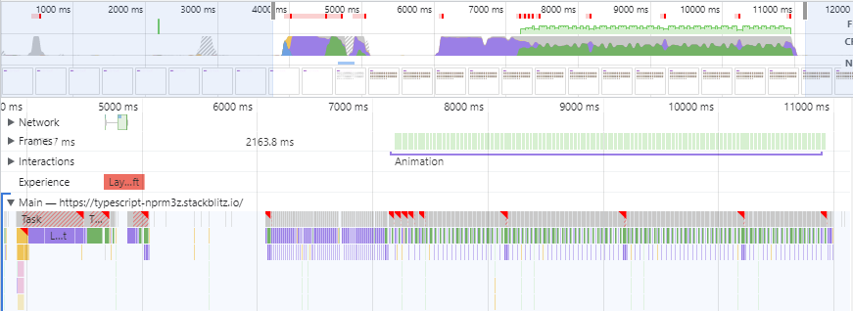
unoptimized - runtime - inc. offscreen nodes
bootstrap
animation

Slide 37
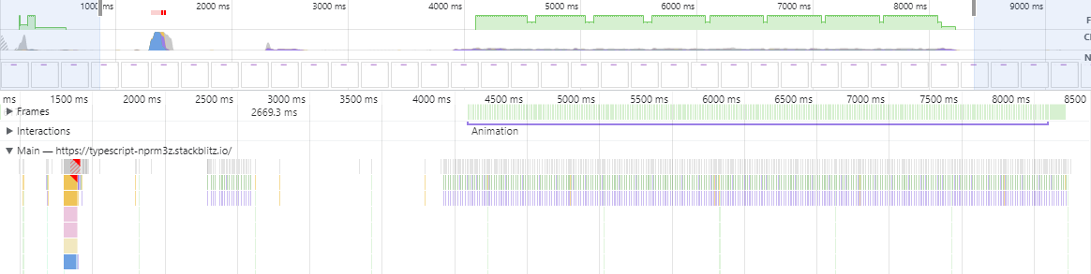
optimized - runtime - inc. offscreen nodes
animation
bootstrap

Slide 38
Test Lab
🧪

Slide 39
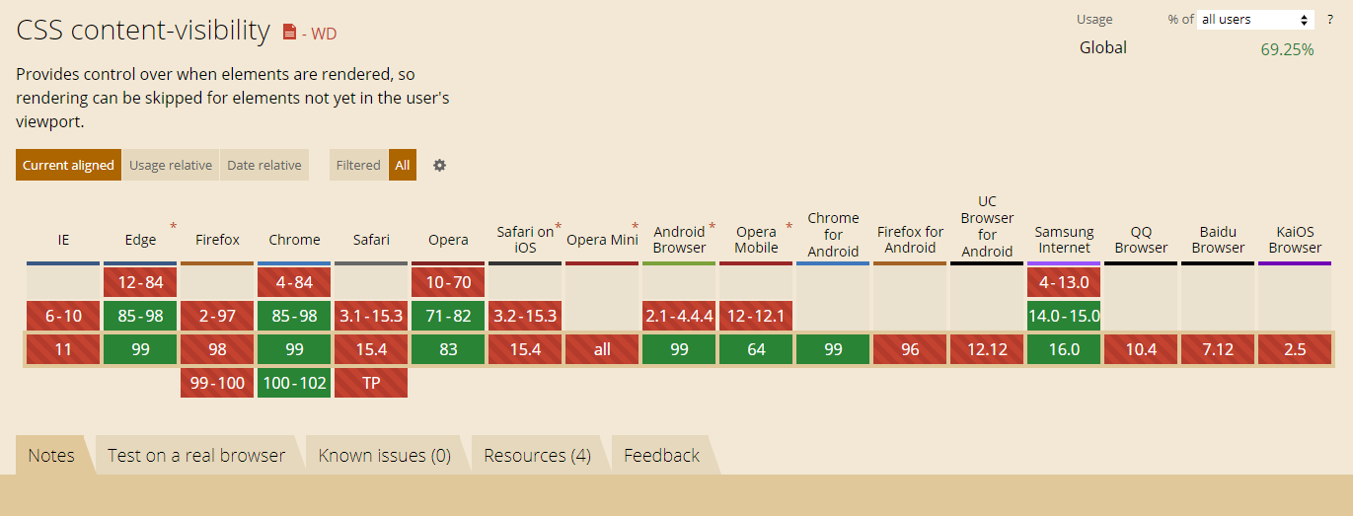

Slide 40
real-world measurement
contain and content-visibility

Slide 41
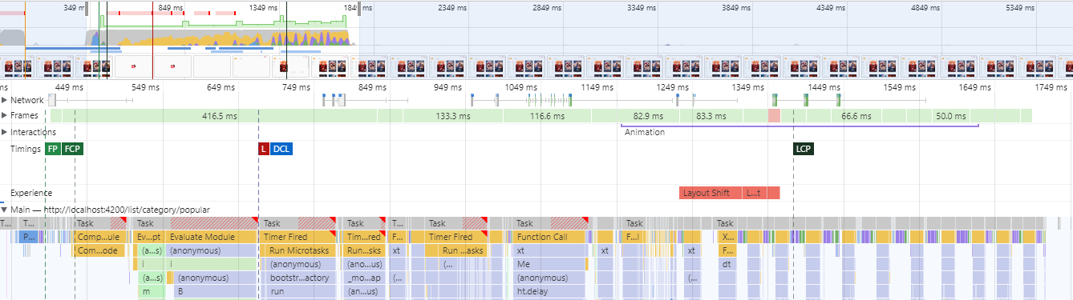


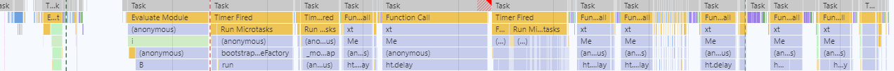

Angular Movies
before
after
contain and content-visibility
Initial paint
header
sidebar
genres
movie list rendering
sidebar
158ms Rendering
30ms Paint
Initial paint
header
sidebar
genres
movie list rendering
sidebar
25ms Rendering
7ms Paint
tastejs.com/movies - 2022

Slide 42

huge number of elements + live editing
contain and content-visibility
Interaction | Original (TTB) | Fixed (TTB)
Initial load | 589ms | 304ms
Expanding custom field (1000 entries) | 696ms | 0ms
Clearing search (1000 entries) | 648ms | 0ms
Expanding places (282 entries) | 257ms | 0ms
Editor load | 543ms | 280ms
List rendering | 198ms | 59ms
clickup.com - 2022

Slide 43
Demo & Exercise Time!
CSS Contain

